Slide 1

aSES
Automated Student Engagement System
Team Name: ASEAN Boleh
DEVPOST link: aSES DEVPOST
Team Members:
Lee Juin @Neo-Zenith
Daniel Tan Teck Wee @DanielTanTWOfficial
Ng Woon Yee @woonyee28
Lee Ci Hui @perfectsquare123
Weng Pei He @wph12
Bernice Koh Jun Yan @bernicekjy

Slide 2
Background
Problem Statement
In line with the seven National AI Projects that address Key Challenges in Singapore, we decided to focus on the Education section. Our objective is to provide personalised education for students through enhancing the learning experience for both teachers and students
A study showed that 64% of students struggle to maintain focus and discipline over online learning
With classes held in online settings, teachers also struggle to track the level of engagement of all students
If teachers knew how engaged and focused their students are in class during certain periods of time, they can improve their teaching methods by:
Adjusting their teaching pace
Putting more emphasis on harder topics
How might we harness AI to help teachers determine the level of engagement of students in online learning?
Notes:
Reference:
https://iblnews.org/a-survey-shows-that-many-college-students-struggle-to-maintain-focus-and-discipline-in-distance-learning/

Slide 3
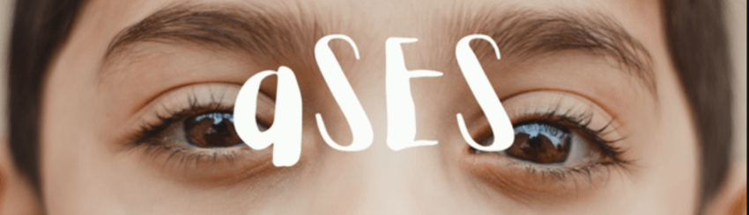
Our solution
How might we harness AI to help teachers determine the level of engagement of students in online learning?
aSES (Automated Student Engagement System):
A computer vision based system that tracks students level of engagement in real-time during an online class session
DURING CLASS
System is run on the students’ devices
During online classes, student engagement is tracked via their webcam
After class, results are uploaded to the cloud
Based on Eye Aspect Ratio measurement and face detection.
Every second, the student is categorised as engaged or disengaged based on their eye movements
->Disengaged: when the student’s face is undetected OR their eyes are closed/ partially closed for a fixed period of time (ie. 2 seconds)
AFTER CLASS
Through the system portal, teachers can observe reports on student engagements for:
Individual students
The entire class
By querying their names, course, module, group and matriculation number
The reports show the graphical results of student engagement against the time since the class started
Notes:
Based on Eye Aspect Ratio measurement and face detection
The student is categorised as engaged or disengaged based on their eye movements
Disengaged: when the student’s face is undetected OR their eyes are closed/ partially closed for a fixed period of time
App can be run on the students devices during online classes to analyse student engagement
Teachers receive information regarding student engagement via _____ , where they get feedback on the amount of time students spent disengaged and the engagement level over time in the form of a graph

Slide 4
Tech Stack
FRONT END
Django Template and Streamlit
Process Video Input
Display Statistical Data
AI MODEL
OpenCV with Python dlib
BACKEND
Django
Store Engagement Data
Retrieve Student Data
SERVER LAYER
SQLite
Notes:
Source:

Slide 5
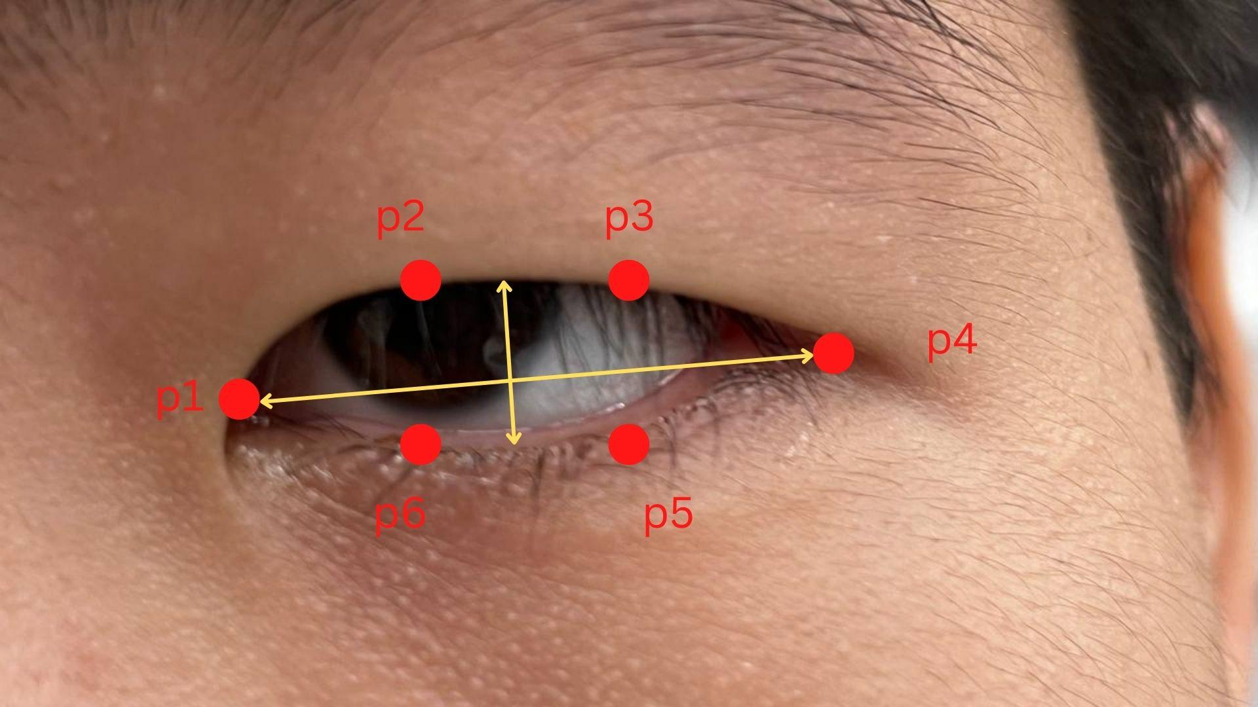
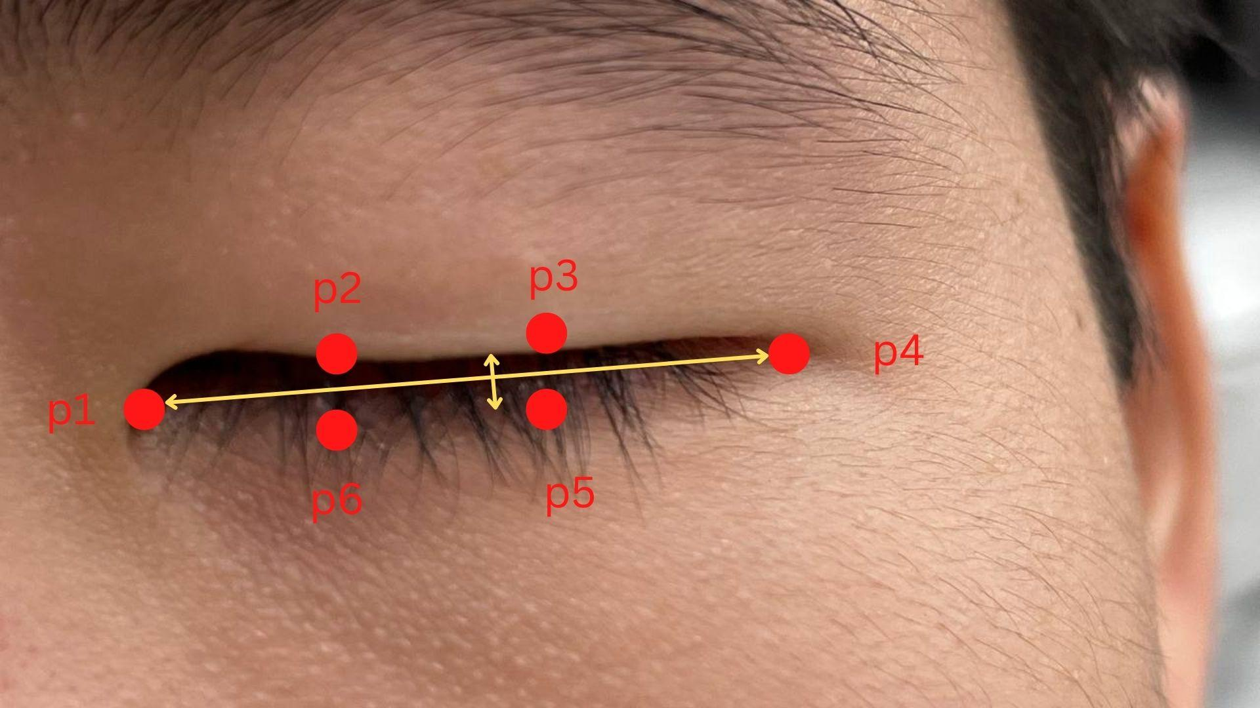

Ai model
Method:
OpenCV with dlib as our main machine learning libraries.
Detect face using "HOG-based" face detector from dlib
Predict Facial Landmarks using dlib and obtain Facial Landmarks index for both eyes using module face_utils
Live video streaming through USB/webcam/Raspberry Pi camera using module VideoStream in library imutils
Eyes open
Calculate the average Eye Aspect Ratio (EAR) of each student:
Eyes close
The 2D facial landmark locations of each eye is represented by 6 (x,y) -coordinates starting from the left-corner of eyes (from the perspective of 3rd party), and plotting it clockwise evenly for the remaining region.
Eyes open: EAR approx. constant
Eyes closed: EAR = 0
For the first 5 seconds, we calibrate the average of EAR of the student.
We then set a threshold of 90% of average EAR to signify closed eyes.
Notes:
Source:

Slide 6
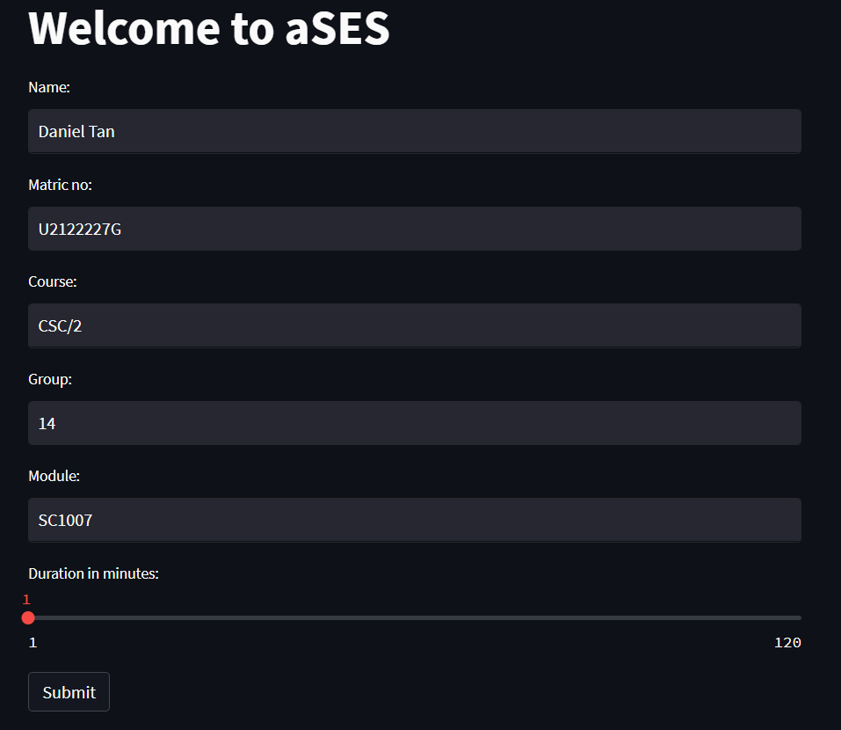
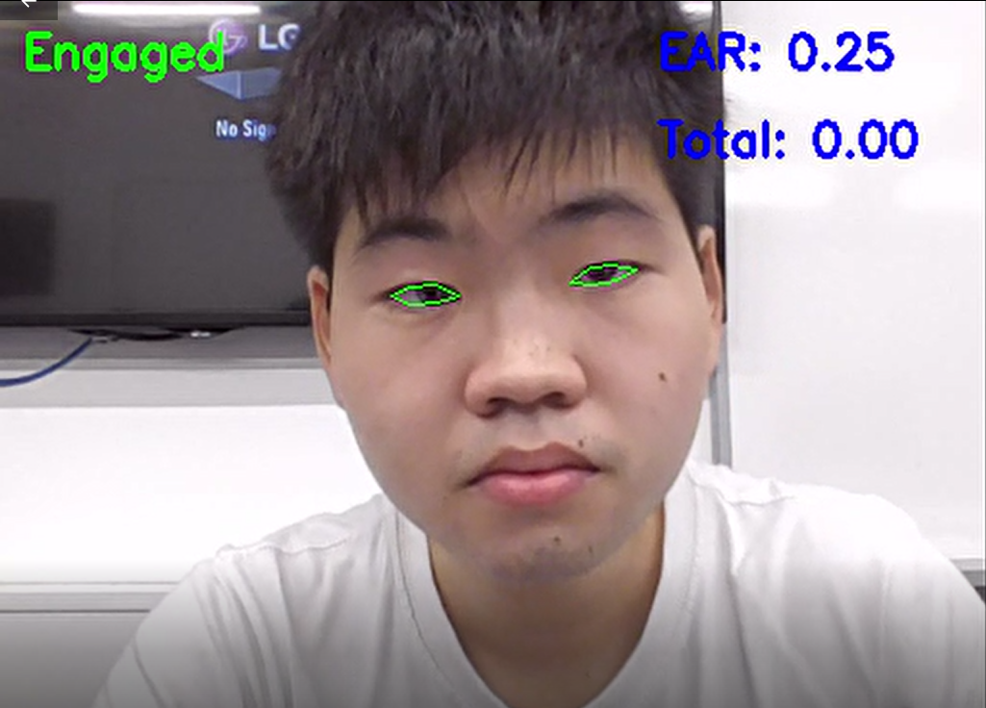
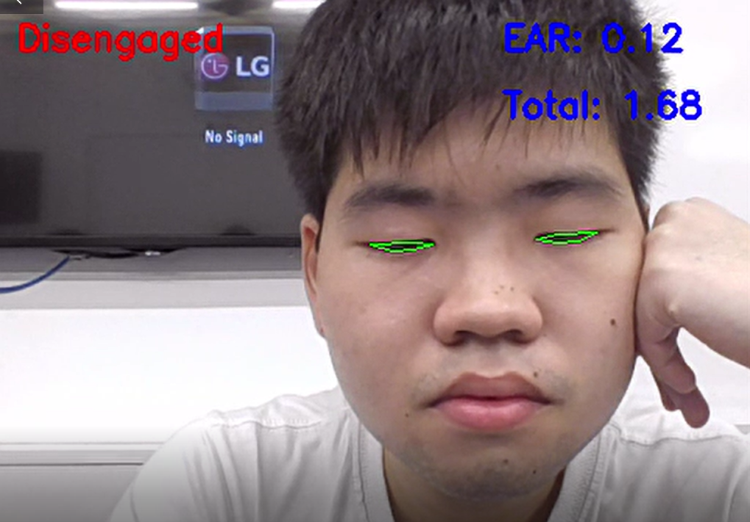
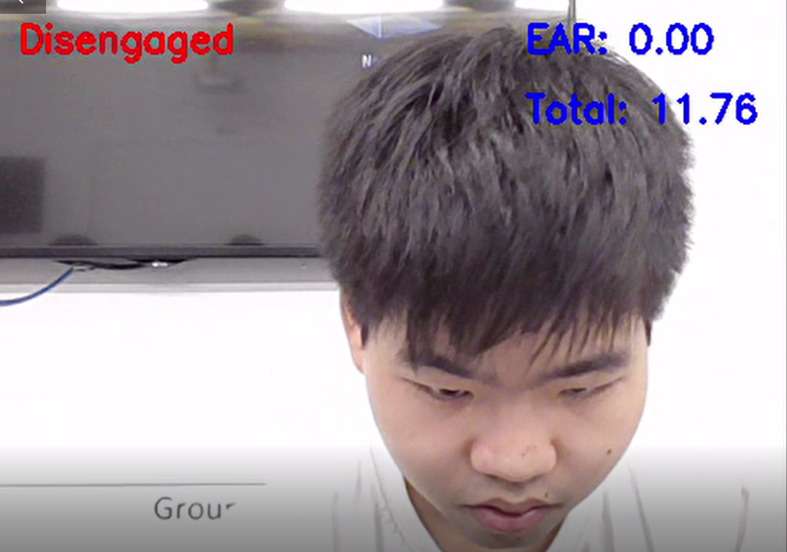
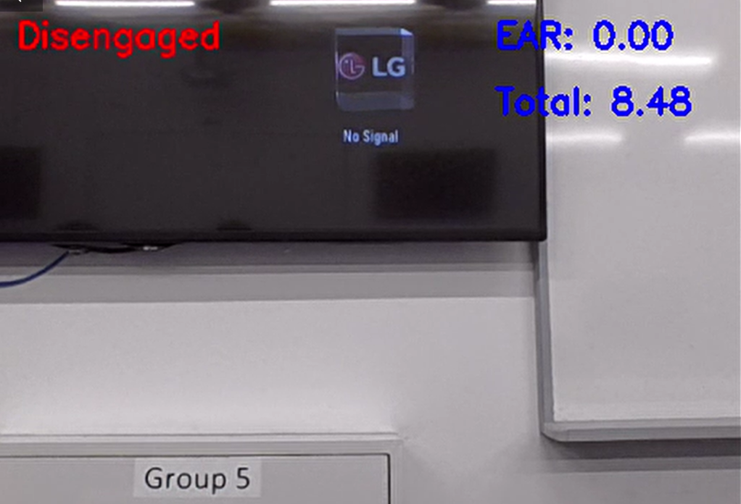
Results : CLIENT SIDE
Able to indicate that students are disengaged when eyes are closed, face is not looking at the screen and when student moves away from the device.
Simple form to record student and class information at the start of each session.

Slide 7
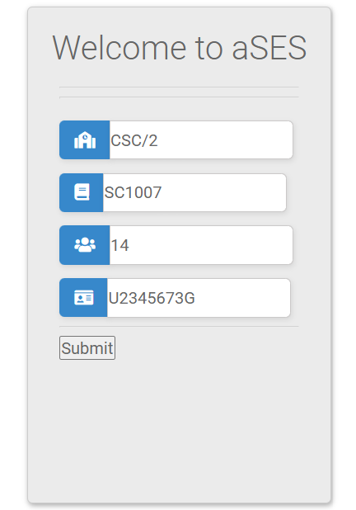
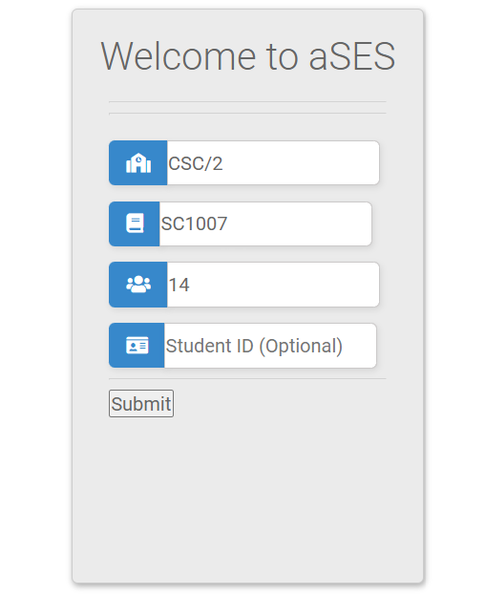
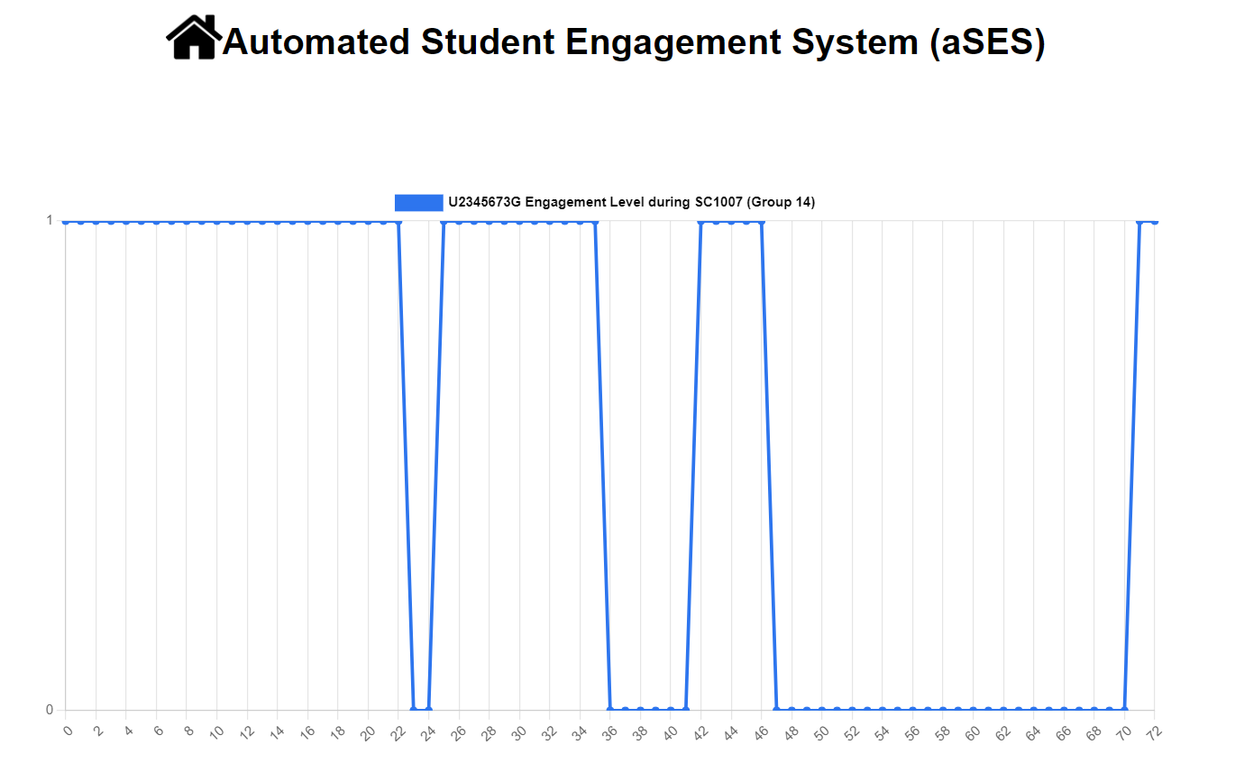
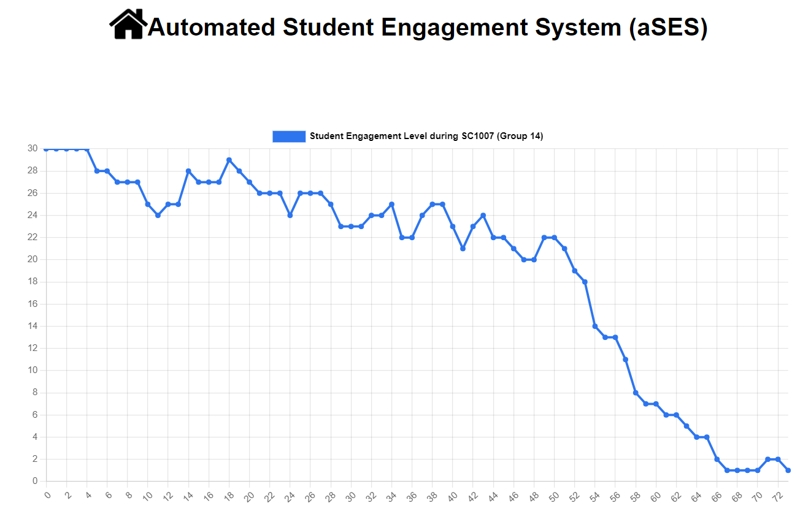
Results: SERVER SIDE
After the class, teachers can view the statistics of the engagement levels of their students at any particular point of time throughout the duration of the class, either for an individual or for the class as a whole.
Individual Statistics
Class Statistics
Leave this section blank

Slide 8
Business aspects
Advantages
Future Improvements
Business plan
No data privacy issues: videos of students are not stored, only data on student engagement are stored in binary form (Engaged (1)/Disengaged (0))
Fast, efficient and easy to implement, as simple calculation used for Eye Aspect Ratio which is based on the ratio of distances between facial landmarks of the eyes, rather than traditional image processing methods that are more complex
All codes used are open source => cost savings (low overall budget)
High quality => continuous improvement
Benefit the student community and general public. For example, detecting the engagement status of a bus driver on a long ride to ensures the passenger's safety.
Eye detection algorithm can be improved for greater accuracy
Dependencies can be built into a client program for easier installation
Solution can be expanded to include facial recognition with multiple users in the field of vision
Applicable to in-person learning in lecture theatres/ classrooms
To inherit the excellent trait of an open-source project, we have decided to
release our project as open source to allow other people to build on top of our project and constantly improve it
until one day we receive enough funding from angel investors.
After receiving the grant, we will turn the project into private, hire sophisticated software programmers to improve on top of the base, then release the product on a subscription basis for the general public.

